Slide 1
Audio & Video Chat Web Application using WebRTC
Mohamed Azarudeen S

Slide 2
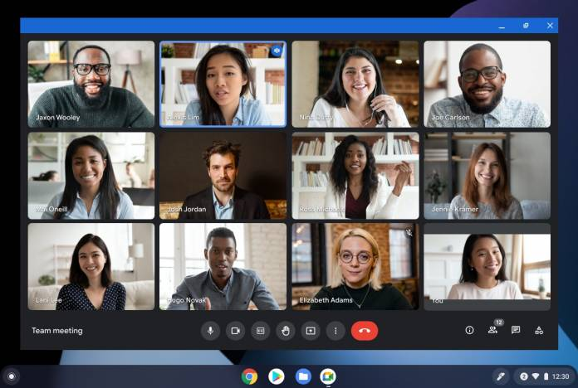
Introduction
WebRTC - Web Real-Time Communication
This web application establishes a live connection between two or more than two users at different geographic locations, using computer networks for the transmission of audio and video data.
Screen sharing and call recording options are included in this application.

Slide 3
Scope
It enables voice and video communication between two and more than two users.
This web application is secure and reliable.
The use of WebRTC ensures that we send the data over secure data channels thus preventing anyone from gaining access to the data being transmitted.

Slide 4

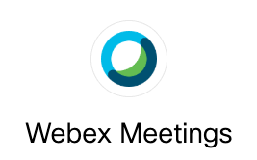
Problem statement
If we want to make video call, we have to install some video call applications like Zoom, Webex, etc.
Need high internet bandwidth connection.
Large size of recorded video file.

Slide 5
Advantages
Low latency delivery and networking
Platform and device independence
Adapts to any network connection
Secure voice and video calls
Compressed size of recorded video calls

Slide 6
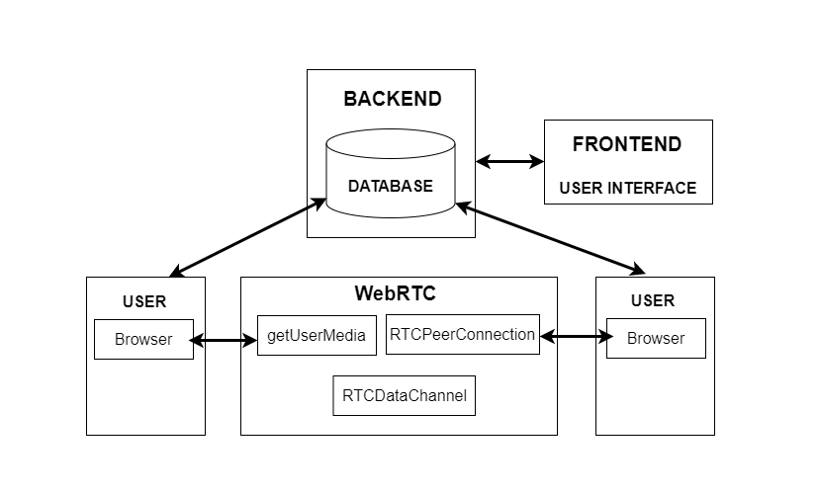
Architecture diagram

Slide 7
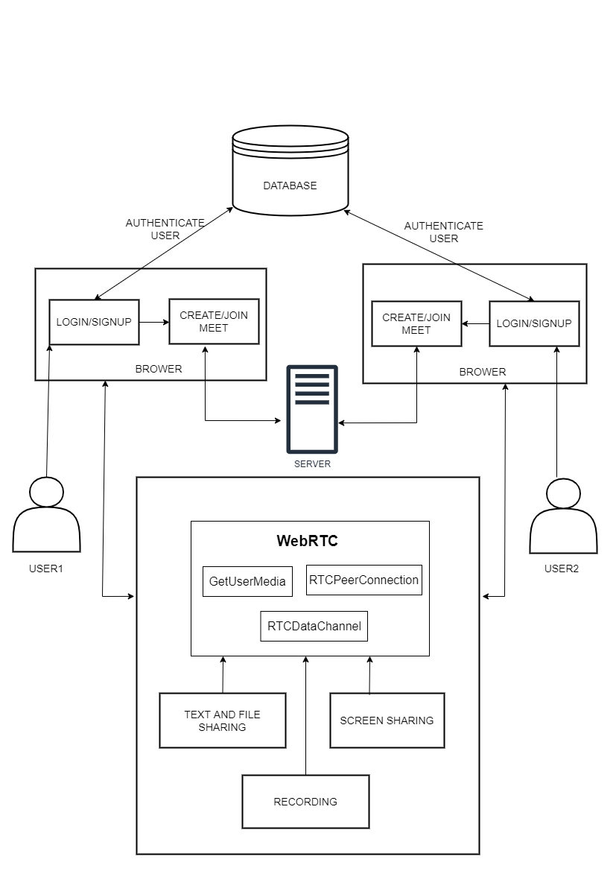

Slide 8
Thank You

